Slide 1

Detecting Profanity
In
Social Media Comments
Under the guidance of
Dr. Isaac K. Gang
Sponsored by
Accenture Federal Services

Slide 2






Team
Highlights
Kuldip Gadapa Developer
Keerthi Gollamudi Developer
Nikhita Sagi Developer
Saathvika Kommisetty Product Owner
Harsha Vardhan Velugoti Scrum Master

Slide 3
Accenture Federal Services
Accenture is a private multinational professional services company serving clients in over 120 countries.
Accenture Federal Services serves government agencies in the United States and helps its clients manage change, modernize information systems, optimize key headquarters governance and processes, and create improvement strategies.
Project POC:
Scott Nestler, Director of Statistics & Modeling
Sieu Tran, Software Engineering Specialist
Danielle Russell, Business and Technology Delivery Senior Analyst

Slide 4
Project Development Phases
Problem Statement
Understand the scope and expectations of the problem.
Dataset Exploration
Identify and explore various datasets to perform data quality assessment.
Model Development
Explore different DL/ML techniques to identify the optimal model for classifying.
Visualizations
Create reports and dashboards for the data and results.
Final Results
Document and present the process and findings. Also, create functional and technical documents.
SPRINT 1
SPRINT 2
SPRINT 3
SPRINT 4
SPRINT 5

Slide 5


Problem Statement
To explore various techniques to differentiate between a Profane and a Non-Profane comment.
Build a classifier model to predict the given input comment as Profane or Non-Profane.

Slide 6
Dataset Description
Dataset | Hate Speech and Offensive Language Dataset | Toxic Comment Classification Challenge Dataset
Dataset Owner | NA | Jigsaw
Dataset Type | Open Source | Open Source
Dataset Size | 3 MB (23353 comments - 19190 (Profane) + 4163 (Non-Profane) | 55 MB (159571 comments - 8449 (Profane) + 151122 (Non-Profane))
Dataset License | CCO Public Domain | CCO Public Domain
Dataset Location | Internet (kaggle) | Internet (kaggle)
Dataset Time Range | 2019 - 2020 | 2018

Slide 7
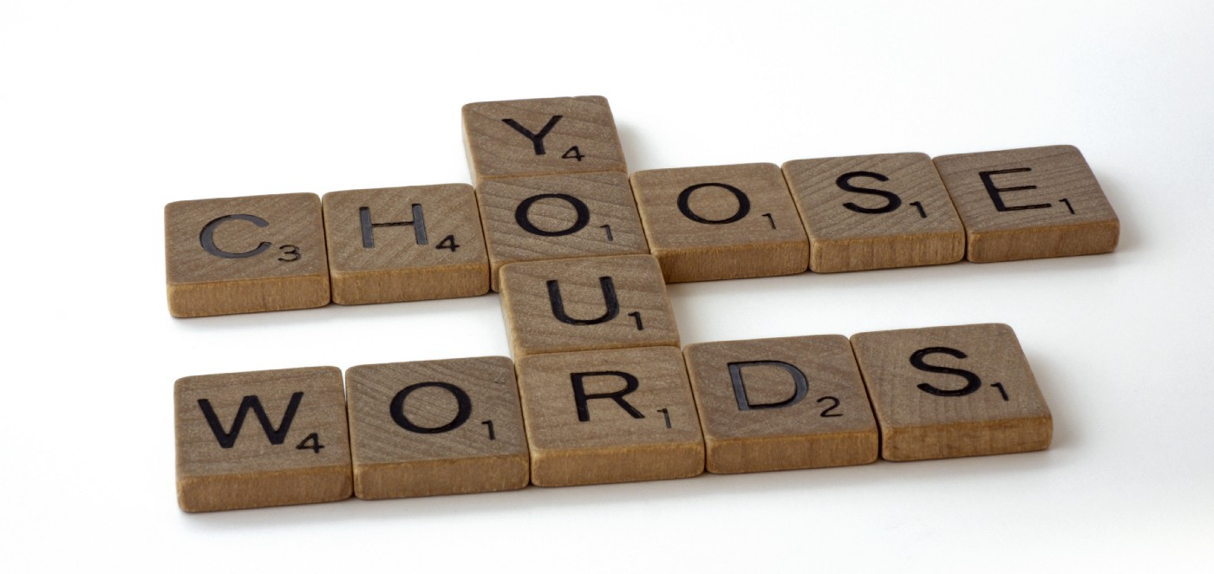
Text Augmentation Techniques
Text Augmentation is used to generate additional, synthetic data using the existing data.
Implemented to balance the number of profane and non-profane comments.
The following text augmentation techniques were implemented:
Character Augmenter:
dog -> d0g
Word Augmenter:
The quick brown fox jumps over the lazy dog -> The quick brown NBC jumps over the lazy dog
Contextual Word Embeddings Augmenter:
The quick brown fox jumps over the lazy dog -> The lazy quick brown fox always jumps over the lazy dog

Slide 8
Generation of Synthetic Data - Text Augmentation
In NLP, Back Translation is one such augmentation technique that works as follows:
Give an input text in some source language (e.g. English)
Translate this text to a temporary destination language (e.g. English -> Spanish)
Translate back the previously translated text into the source language (e.g. Spanish-> English)
Distribution of the datasets:
Dataset | Total number of comments in Dataset | Count of Profane | Count of Non-Profane
Original | 55802 | 27639 | 28163
Back Translated | 38360 | 19190 | 19170
Original + Back Translated | 93692 | 46829 | 46863

Slide 9
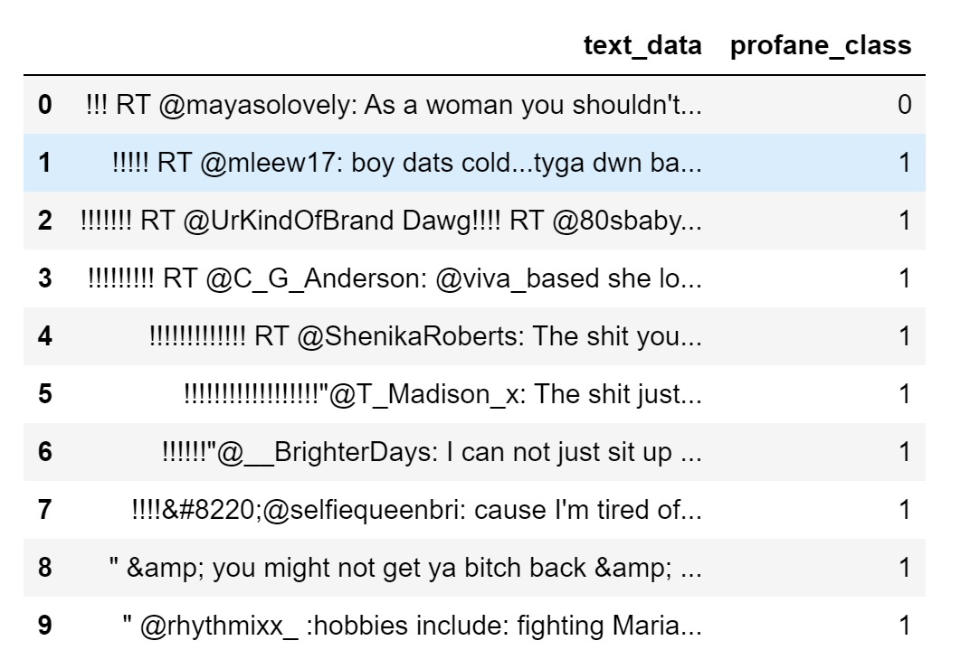
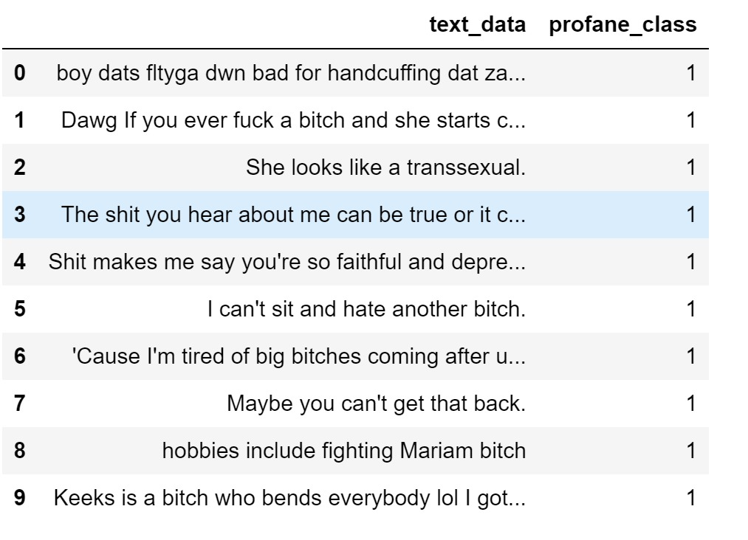
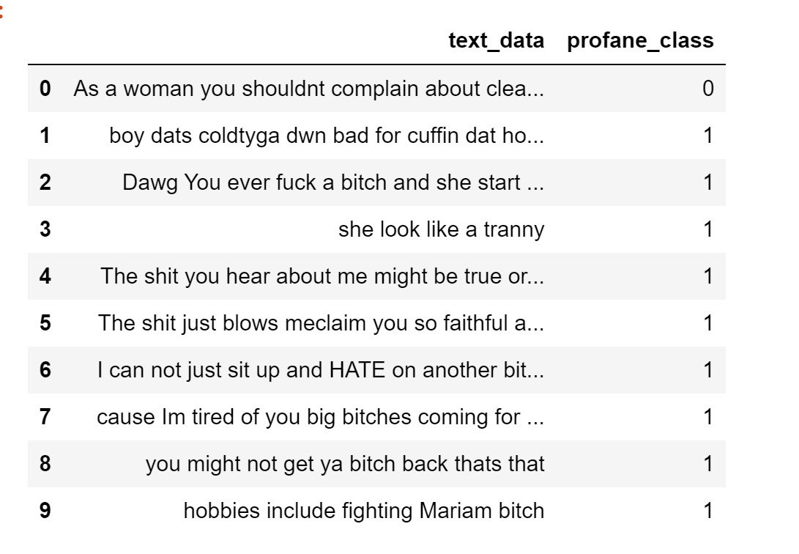
Data
Preprocessing
Original data
Back translated data
Cleansed data

Slide 10
Model Development - Model Metrics
Type of Model | Dataset | Accuracy | Precision | Recall
Feed Forward Neural Network | Original Dataset | 72% | 73% | 72%
Feed Forward Neural Network | Original + Back Translated Dataset | 76% | 76% | 76%
Naive Bayes | Original Dataset | 90% | 92% | 87%
Naive Bayes | Original + Back Translated Dataset | 92% | 94% | 89%
Recurrent Neural Network | Original Dataset | 92% | 91% | 92%
Recurrent Neural Network | Original + Back Translated Dataset | 94.3% | 94.2% | 94.5%

Slide 11
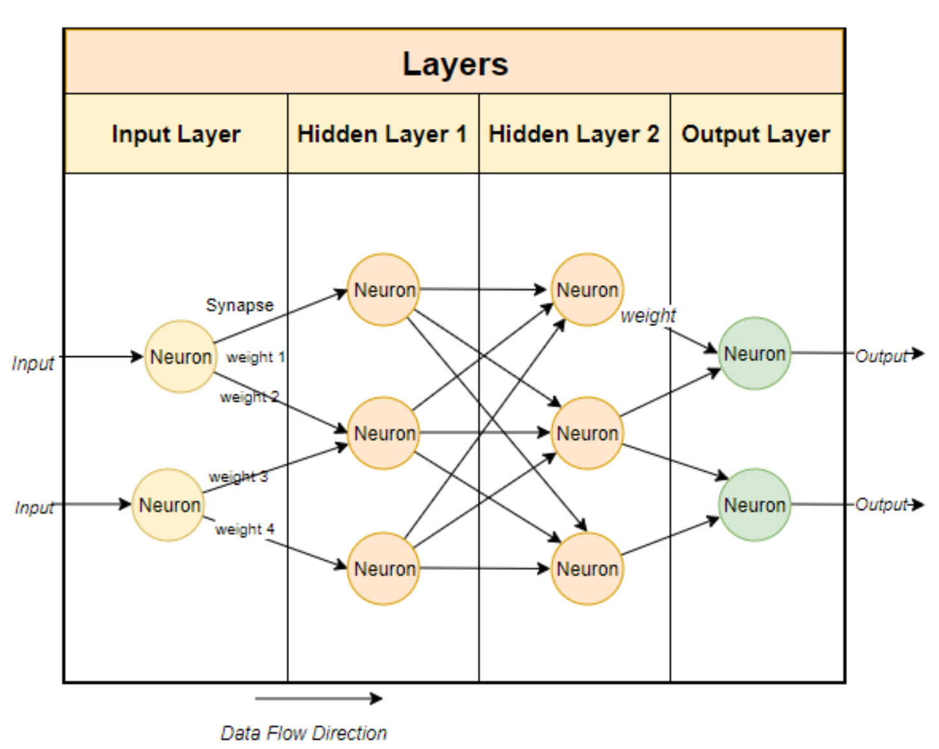
Neural Networks
Subset of machine learning and are at the heart of deep learning algorithms.
Comprises of node layers, containing an input layer, one or more hidden layers, and an output layer.
Each node, or artificial neuron, connects to another and has an associated weight and threshold.
For a text data in NN, length of all sentences should be equal. So, we append special <PAD> tokens.

Slide 12
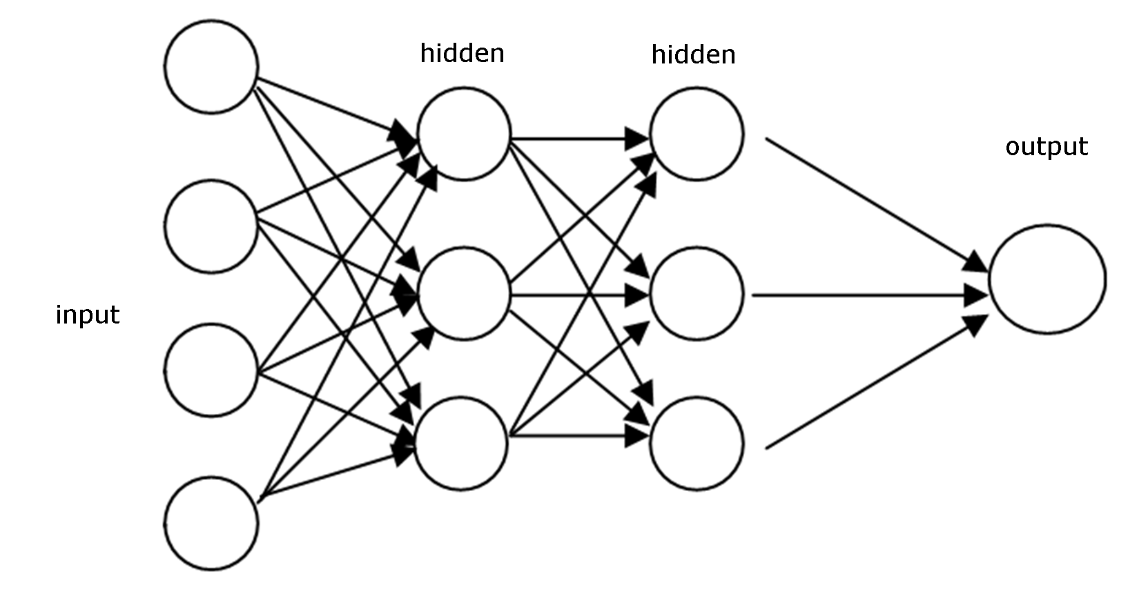
Feed Forward Neural Network
The feed forward neural network model is the simplest form of neural network as information is only processed in one direction and never backwards.
Activation function used - ReLu (rectified linear units)
Epochs - 100 ; Hidden layers - 2 with size 500
Loss function - CrossEntropyLoss()
Optimizer - SGD(Stochastic Gradient Descent)

Slide 13
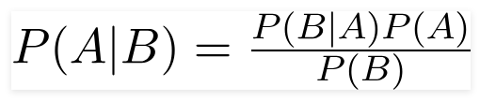
Naive Bayes
A Naive Bayes classifier is a probabilistic machine learning model that’s used for classification task.
The algorithm just assumes that each input variable is independent.
The crux of the classifier is based on the Bayes theorem.

Slide 14
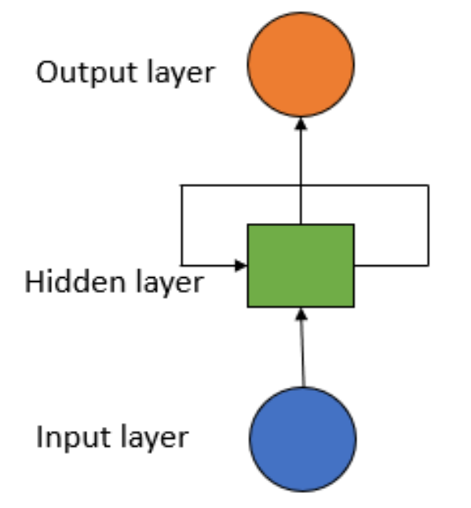
Recurrent Neural Network
Works on the principle of saving the output of a layer and feeding this back to the input in order to predict the output of the layer.
Works in three stages.
In the first stage, it moves through the hidden layer and makes a prediction.
In the second stage, it compares its prediction with the true value using the loss function.
In the final stage, it uses the error values in back-propagation, which further calculates the gradient for each point (node).
Activation function used : Sigmoid

Slide 15
Confusion Matrix
Recurrent Neural Networks
Naive Bayes
 | Predicted Label
 |  | Non-Profane Comment | Profane Comment
 | Non-Profane Comment | 13245 | 837
 | Profane Comment | 754 | 13272
Actual
Label
 | Predicted Label
 |  | Non-Profane Comment | Profane Comment
 | Non-Profane Comment | 12476 | 728
 | Profane Comment | 1510 | 13394
Actual Label

Slide 16
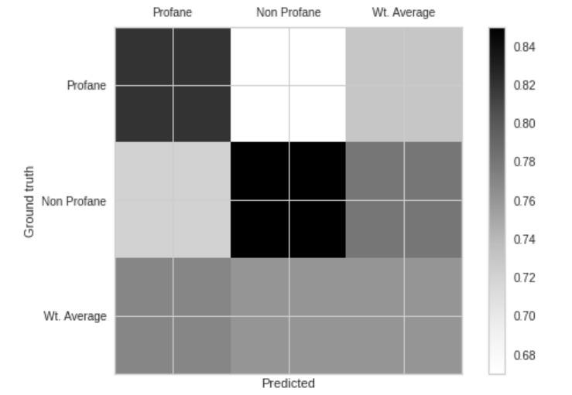
Class Matrix for Feed Forward NN
A class matrix is similar to that of a Confusion Matrix. In the confusion matrix we get the count of the actual and predicted values while in the class matrix we get the percentages of the actual and predicted values.
For example, the cell on the top left represents 82% of the actual profane comments that are classified as profane by the model.

Slide 17
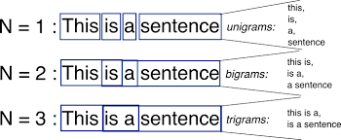
Visualizations
N-Grams are a collection of co-occurring words inside a specific frame.
Different N-grams:
Unigram: A 1-gram (or unigram) is a one-word sequence.
Bigram: A bigram is a sequence of two adjacent elements from a string of tokens, which are typically letters, syllables, or words.
Trigram: A trigram is a sequence of three adjacent elements from a string.

Slide 18
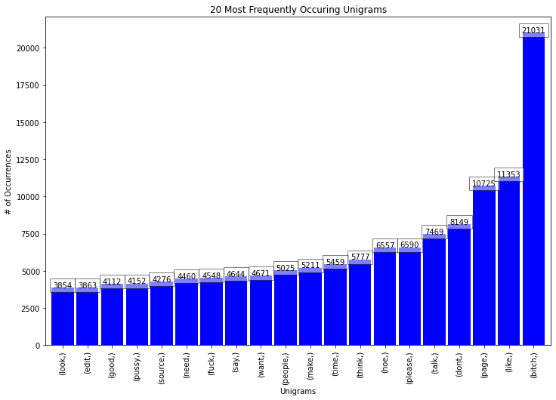
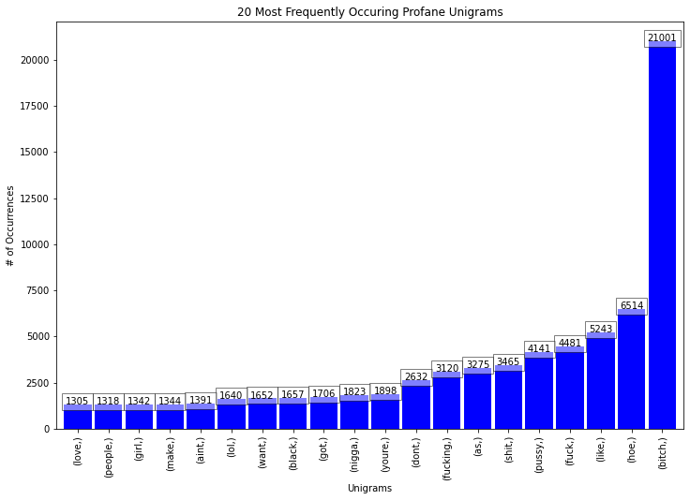
Unigrams

Slide 19
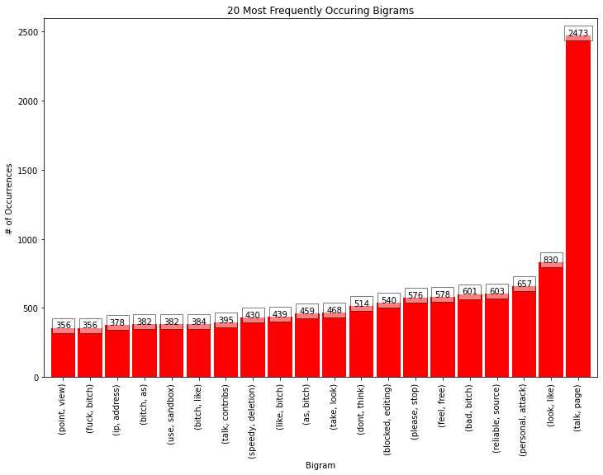
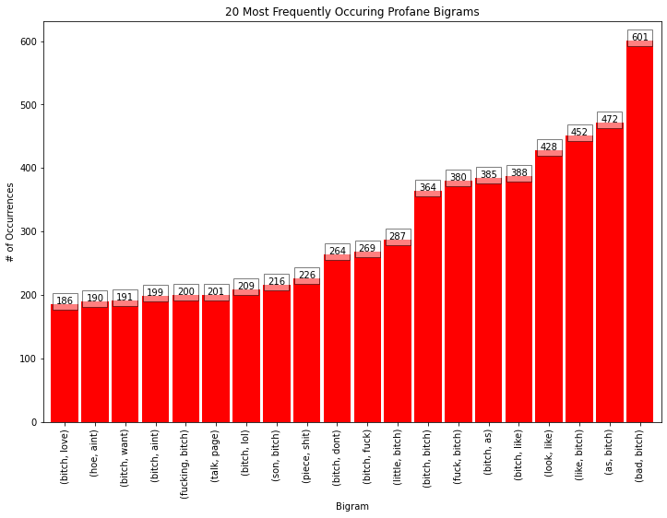
Bigrams

Slide 20
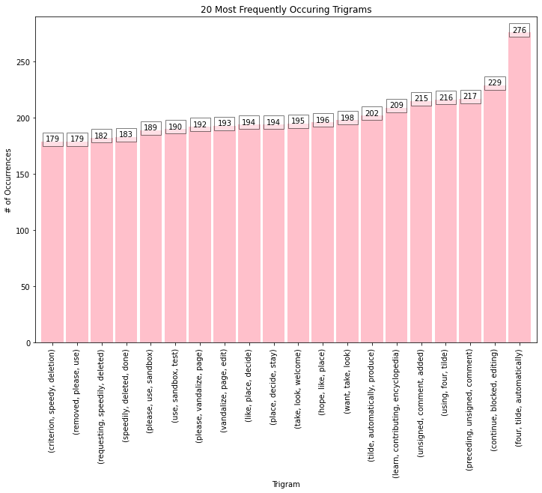
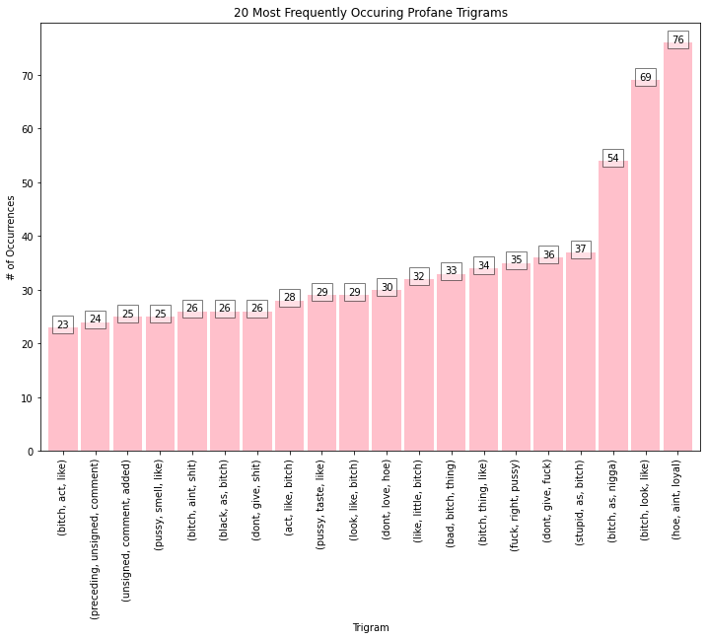
Trigrams

Slide 21
Challenges
Risk | Description | Probability | Impact | Mitigation
Data Imbalance | The data should not be biased | Medium | High | Must train the model with a diverse dataset to make sure the data is not biased
ML/ DL | Should we use ML or DL models | High | High | Should identify appropriate models for the given scenario
Class Inversion | In few cases the non-profane text might change into a profane text due to text augmentation | Medium | High | Try not to perform text augmentation on non-profane data

Slide 22
Final Results
Summary
The dataset consists of Twitter and Wikipedia comments. The dataset is augmented using back translation method to generate synthetic data for profane class.
Neural Networks (FFNN, RNN) and Naive Bayes models are trained on the “original” and “original + back translated” data to classify the comments as either profane or non-profane. The RNN model performed the best with 94.3% accuracy.
Next Steps/Recommendations
Can use comments from other social media platforms such as Meta, Youtube as well.
Can be further developed to detect profanity in Foreign languages.
Implementing other DL/ML models.
Github Repository
https://github.com/skommise/DAEN690_Team_Highlights

Slide 23
Thank You
Q+A

Slide 24
Quality | Twitter text | Wikipedia Comments
Completeness | 100% | 100%
Uniqueness | ✅ | ✅
Integrity | ✅ | ✅
Accuracy | ✅ | ✅
Number of attributes with null values | 0 | 0
Consistency | ✅ | ✅
Conformity | ✅ | ✅

Slide 25
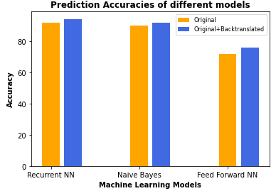
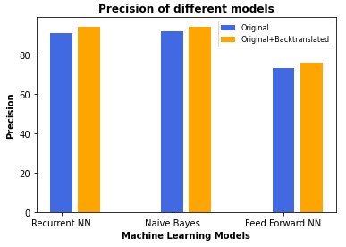
The bar plots below shows comparison between performance metrics of Recurrent NN, Feed Forward NN, and Naive Bayes.
Accuracy is the metric that counts the proportion of correct predictions.
The Recurrent Neural Network has the highest accuracy of 92% for original data and 94.3% for original+back translated data.
Precision is the fraction of relevant instances among the retrieved instances.
The Naive Bayes model has the highest precision of 92% for original data and RNN of 94% for original+back translated data.

Slide 26
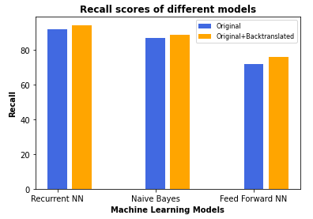
The recall is the measure of our model correctly identifying True Positives.
The Recurrent Neural Network has the highest recall score of 92% for original data and 94.5% for original+back translated data.

Slide 27
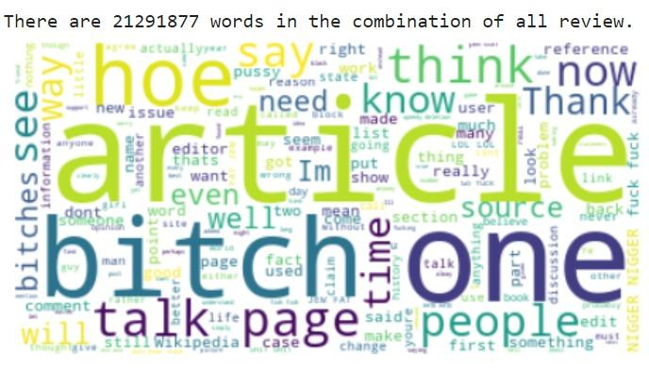
The Word Map shows overall word frequency for both profane and non profane.

